Slide 1
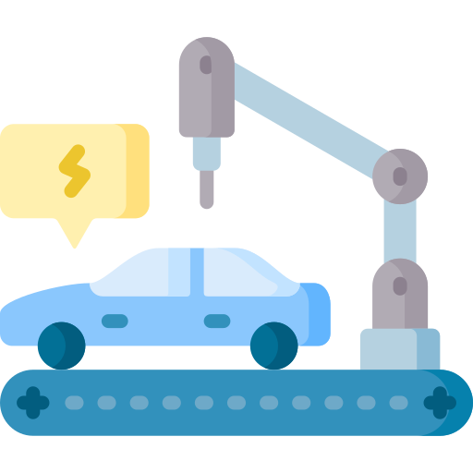
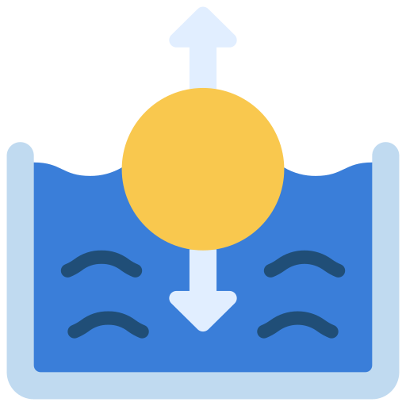

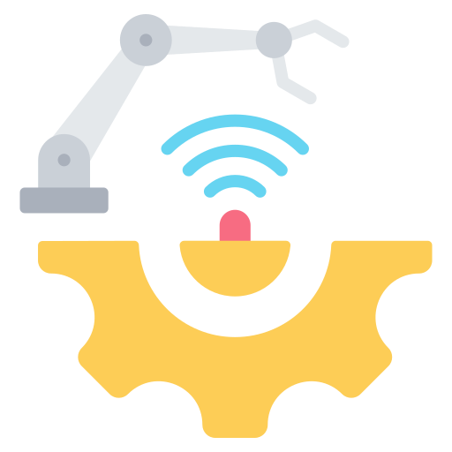


Mechanical Engineering
Robotics
Manufacturing
Automobile
Propulsion
Solid and Fluid Dynamics
Thermodynamics

